Slide 1
Container Services
$whoami
Arun
CDAC,Pune

Slide 2


Slide 3
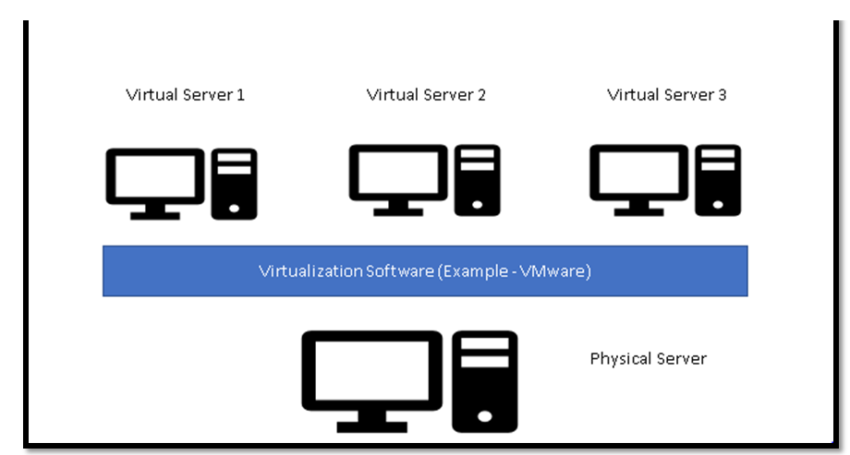

Slide 4
VM – Issues
Own OS, CPU, RAM and Storage
Patching (Patch Tuesday)
Monitoring
License

Slide 5
Hello Containers
Google (Long Time)
All containers = One OS
No license
Less CPU, RAM and storage
IBM System/360
BSD Jails
Solaris zones

Slide 6
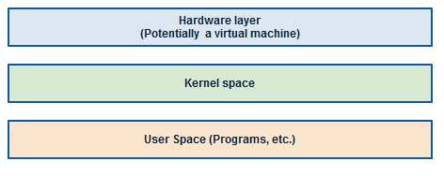

Slide 7
Cgroups (control group) = resource management
Namespaces = Process Isolation
SELinux = Security (RHEL) Access control security policy
(Seperation between host and container) and also multiple container

Slide 8
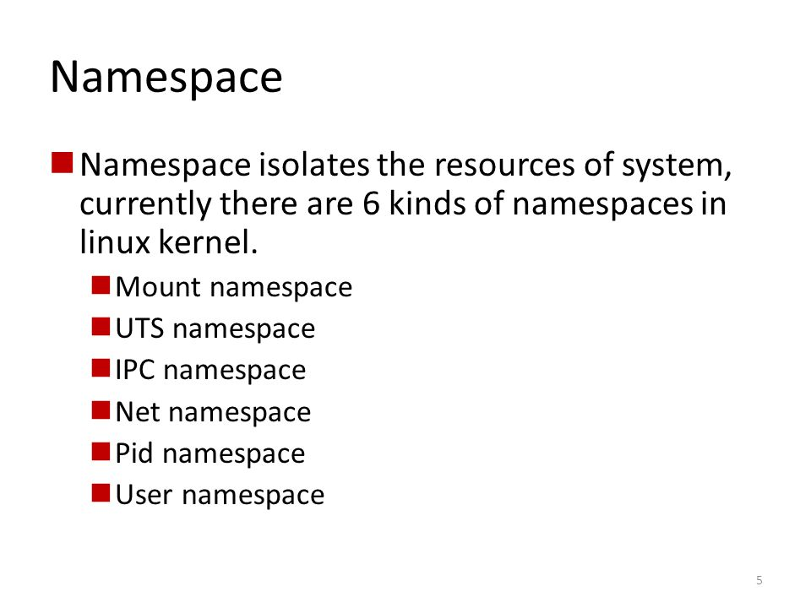

Slide 9
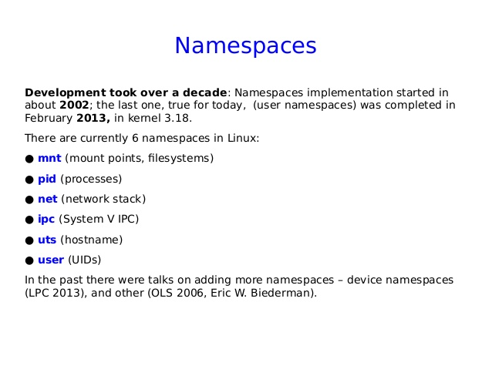

Slide 10
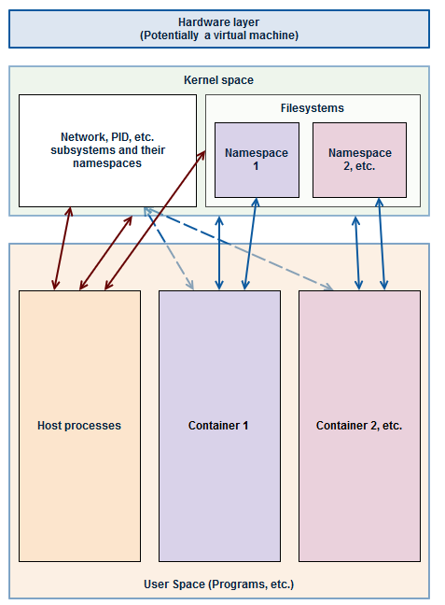

Slide 11
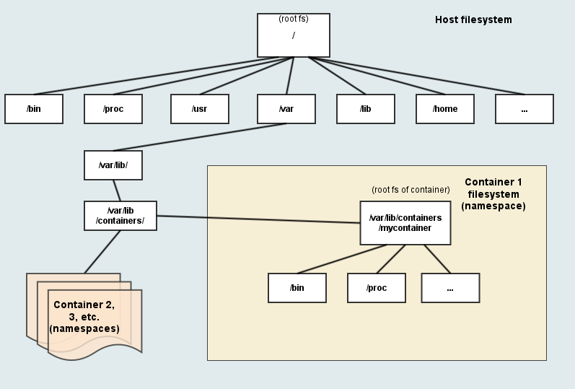

Slide 12
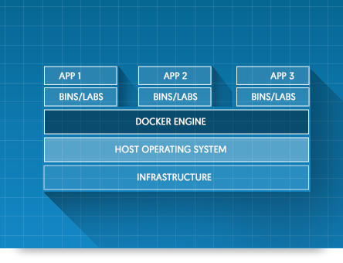

Slide 13
Docker = Dock + Worker
Docker Inc (Company) = 425 ++
Docker (Container Runtime & Orchestration Technology)
Docker ( Open source Project) = Moby

Slide 14
Docker Inc
San Franciso
Solomon Hykes (French-Born) American Developer
Paas (dot cloud)
Docker Conf (Dockercon = 2018 = June 12 – 15 2018 (SanFrancisco)
Docker Conf (Docker con = 2019 = April 29 – May 2 (SanFrancisco)

Slide 15
Docker runtime & Orchestration Engine
Community Edition (4 months = support)
Enterprise Edition (12 months = support)
Version = YY.MM-xx (18.06.0-ce)
18.06.1-ce
Prior (2017) = major.minor (1.13) = last
Quaterly releases
Latest = 19.03

Slide 16
Docker Open-Source Project (Moby)
Dockercon 2017 = Moby
https://github.com/moby
Golang (system-level programing) from Google
Latest DockerCon = April 29th - May 2 (2019) San Francisco

Slide 17
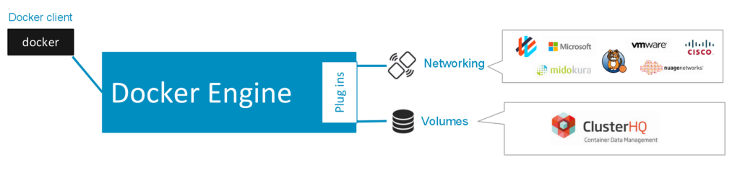
Batteries Included but removable

Slide 18
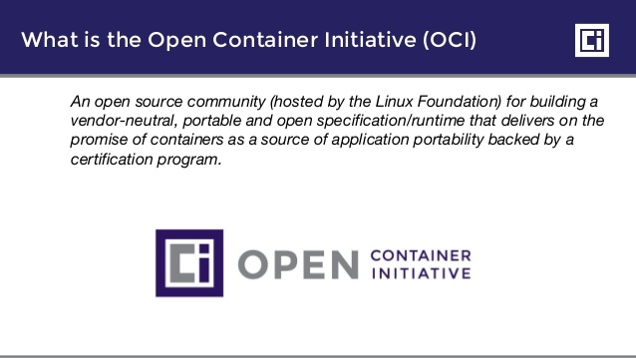
CoreOS = appc (new open standard) and defined image format & container runtime
Rkt (rocket)
“Healthy competition is the mother of invention”

Slide 19
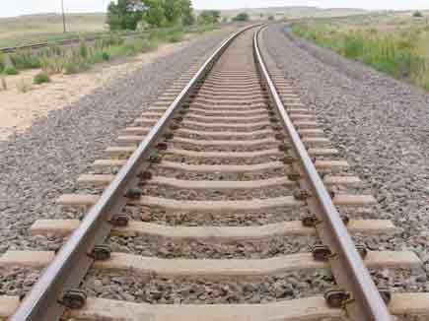

Slide 20
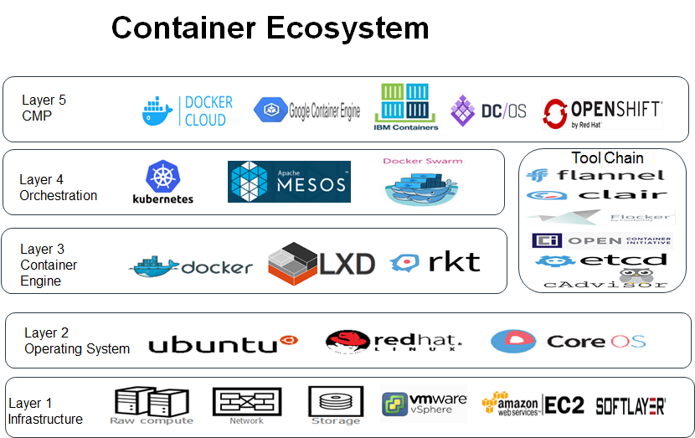

Slide 21
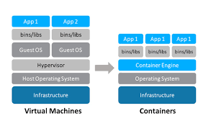

Slide 22
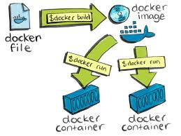

Slide 23
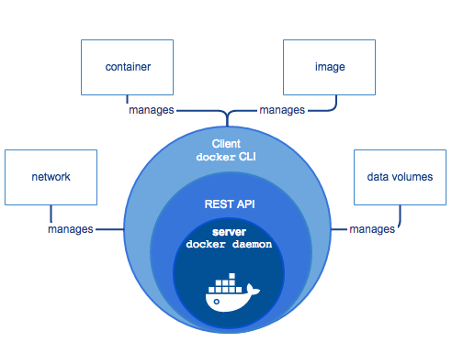

Slide 24
